Slide 1

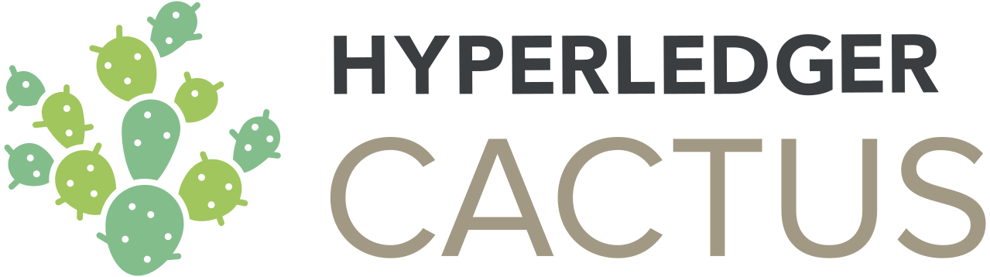
Group 6
&
1801CS30 - Kunj Taneja
1801CS31 - M. Maheeth Reddy
1801CS32 - M. Nitesh Reddy

Slide 2
HYPERLEDGER EXPLORER
A user-friendly Web application tool used to view or invoke transactions, digital wallets, and other information stored in a Hyperledger blockchain deployment.
Provides a GUI that allows users to view the necessary network information of the blockchain.
Been in existence since the inception of the Hyperledger project in 2016.
Being used and contributed to by more than 130 organizations, under the Linux Foundation.
Only supports Hyperledger Fabric.
Notes:
Hyperledger Explorer is a simple, powerful, easy-to-use, open source Web application tool to browse activity on the underlying blockchain network.
It allows users to view, invoke, deploy, or query:
blocks
transactions and associated data
network information
chaincodes
transaction families
any other relevant information stored in the ledger
Hyperledger Explorer attempts to provide an easy visualization by using graphs, charts, pictures, and templates, in addition to the usual search and monitoring facility. We will talk about these visualizations in our next presentation.
It has been in existence ever since the Hyperledger project was started in 2016.
As of now it only supports Hyperledger Fabric at the production level.

Slide 3
Characteristics
Hyperledger explorer has a rich user interface.
It was developed using latest technologies, such as ReactJS, Google Material UI, web-sockets, and others.
It is a blockchain module that can listen, and query a Hyperledger Fabric network.
The explorer is a useful tool in finding and understanding otherwise machine-readable data stored as encrypted ledger entries.
Notes:
Hyperledger Explorer is a web application with a rich user interface, developed using latest technologies, such as ReactJS, Google material ui, web-sockets, etc.
It is a Blockchain module that can listen, and query a Hyperledger Fabric network.
The explorer is a useful tool in finding and understanding otherwise machine-readable data stored as encrypted ledger entries

Slide 4
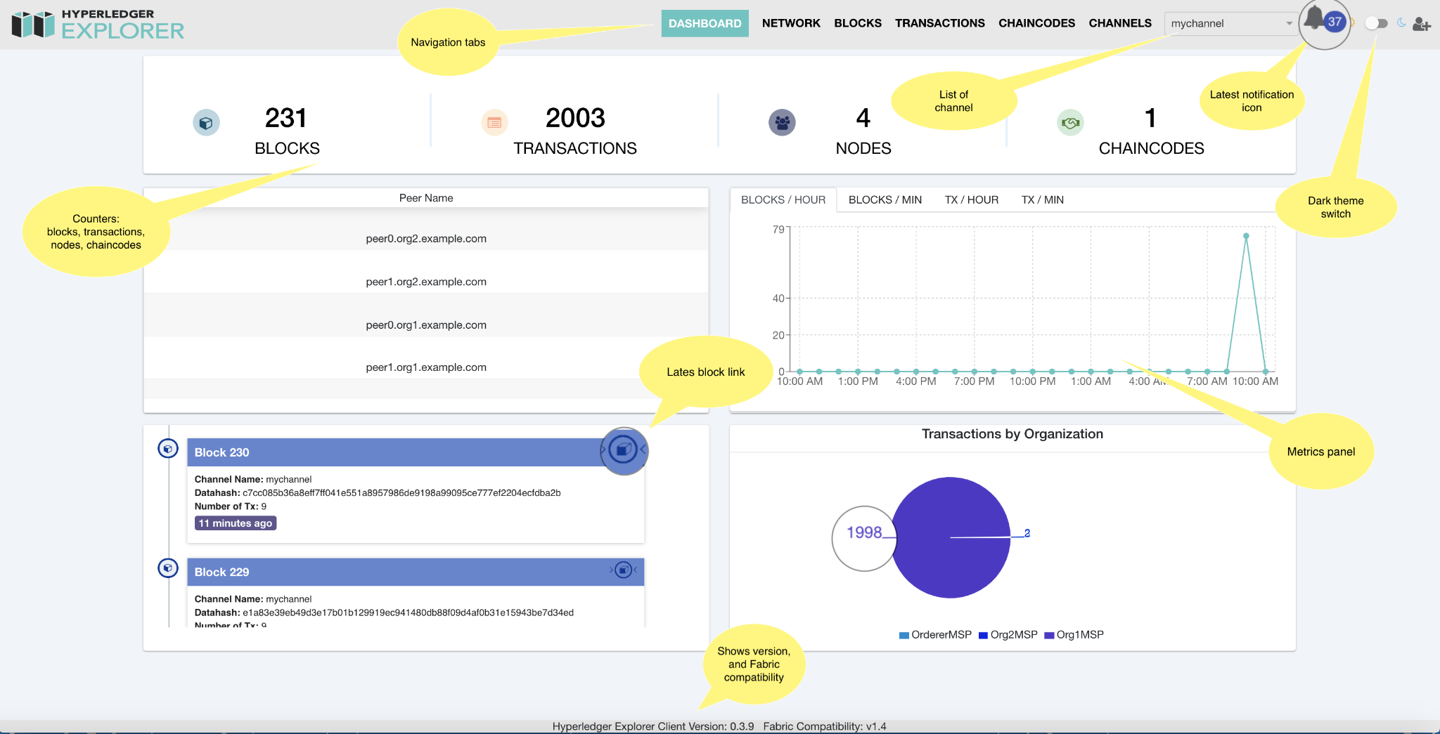
Utilities
3
4
1
2
Notes:
This is how the GUI of Hyperledger Explorer looks like. This is the screenshot of the Dashboard and we can:
Get the latest status of blocks, network, and chaincodes, view blocks, and transactions.
Blocks and transactions metrics by hours, and minutes.
Dynamically discover new channels and switch data presentation by channels.
Get real time notification of new blocks.

Slide 5
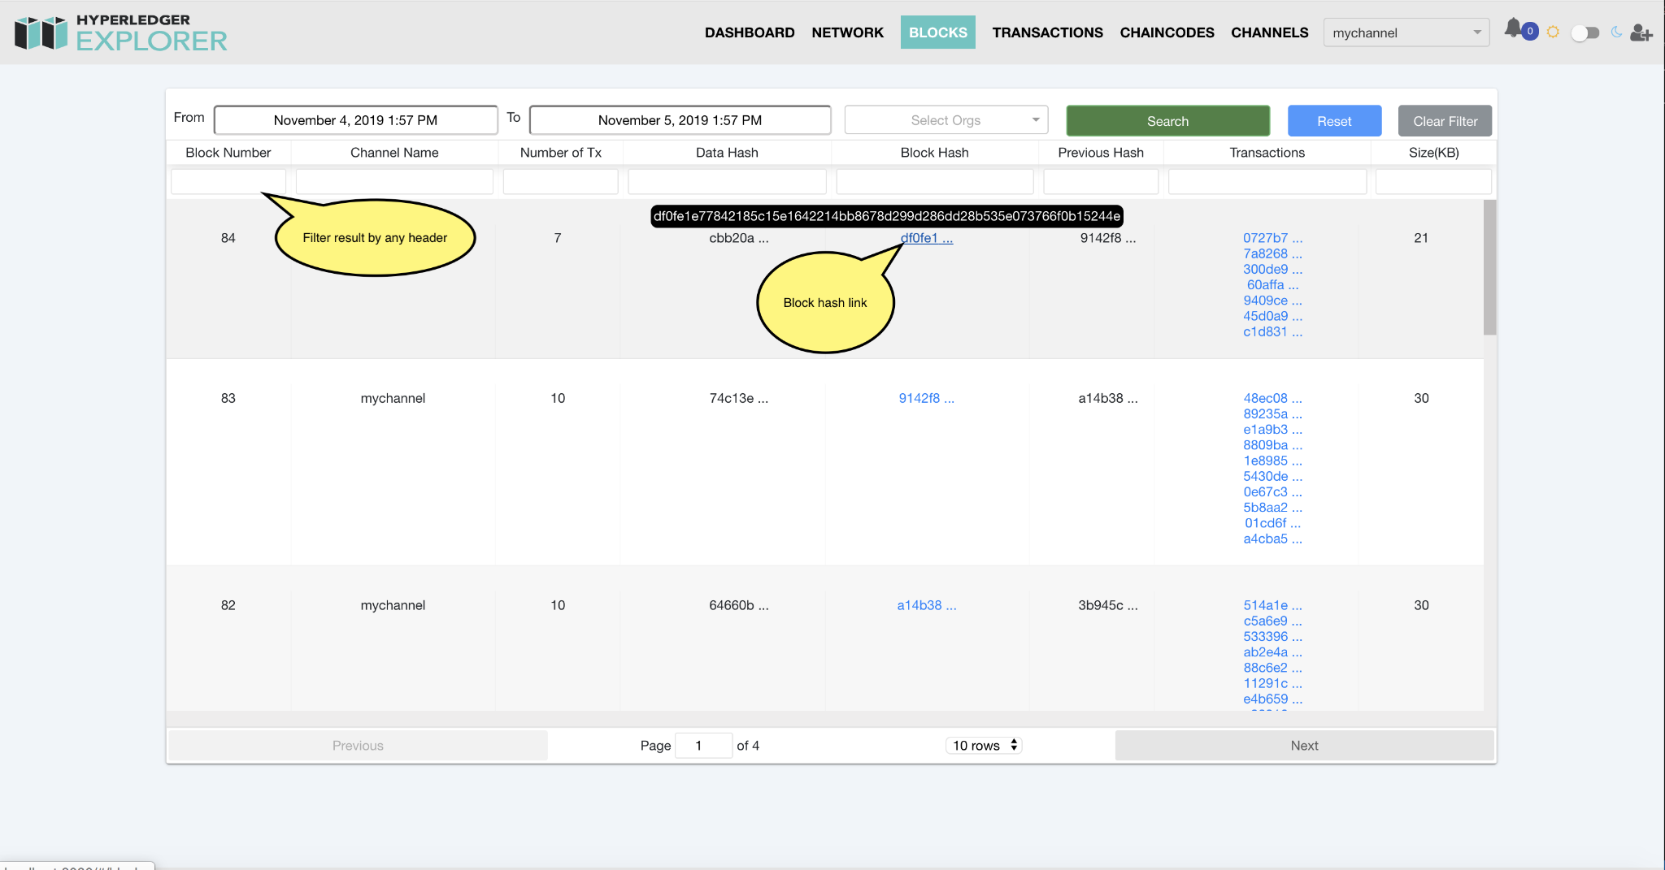
Utilities
4
5
5
1
2
Notes:
Search, and filter blocks, transactions by date range and channels.

Slide 6
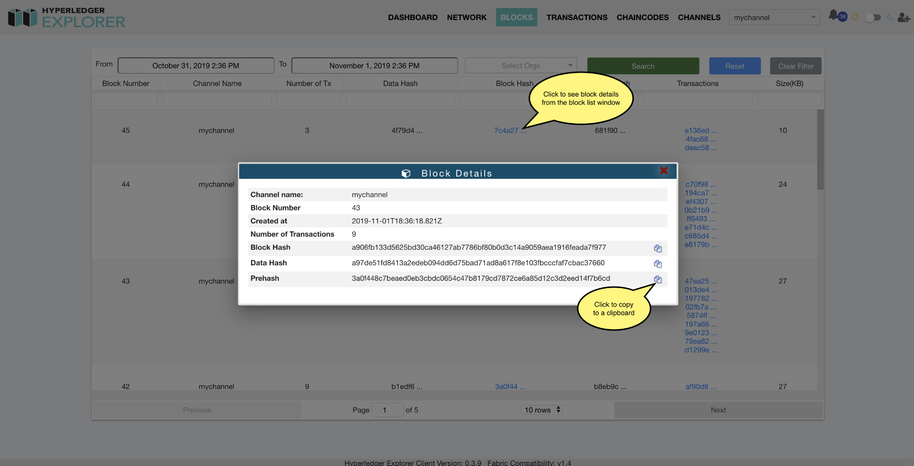
Utilities
4
5
5
1
2
Notes:
Search, and filter blocks, transactions by date range and channels.

Slide 7
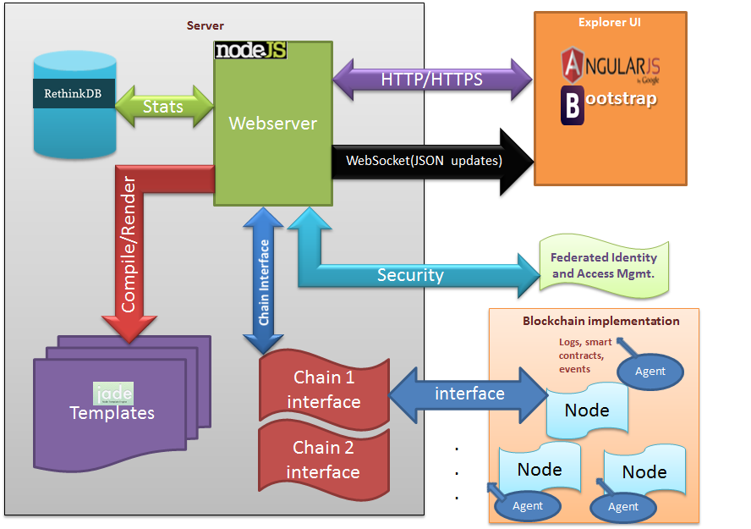
Architecture
Notes:
Hyperledger Explorer consists of:
A web server. Node.js is proposed as a back-end framework for implementing server-side components. Express Node.js serves a web application.
A web UI. With AngularJS, the front-end framework will be implemented. According to the proposal, Angular’s “features like data-binding and directives greatly help in developing reusable components and modular code.” Bootstrap is also used “for its rich UI and responsive features.”
Web sockets. This key API pushes information from the server to clients, and thus “reduces load on clients and server.”
A database. Information about blocks, transactions, smart contracts, etc. is stored in this RethinkDB.
A security repository. “User identity and access management will be implemented using a federated security repository,” according to the proposal. “This will serve as a facade for security implementations from different blockchain platforms.”
Blockchain implementation. Each blockchain must have a separate component “to provide updates on transactions, blocks, node logs, and smart contracts to the Explorer web server,” as the proposal goes. This can be done via websockets.
Other technologies of Explorer’s stack include JavaScript, jQuery, D3.js, and HTML/CSS.

Slide 8
HYPERLEDGER CACTUS
It is a protocol that aims to solve the fragmentation problem or at least aims to solve it with the help of heterogeneous system architecture.
It is a Blockchain Integration Framework
It aims to provide Decentralized, Secure and Adaptable Integration between Blockchain Networks.
It includes a set of libraries, data models, and SDK to accelerate development of an integrated services application.
Notes:
Hyperledger Cactus is an open-source project that aims to provide a decentralized, adaptable and secure integration between blockchain networks.
It was initially proposed under the name Blockchain Integration Framework and allows users to transact on multiple distributed ledgers without introducing yet another competing blockchain.
It offers a protocol to solve fragmentation and interoperability between heterogeneous system architecture.
It consists of:
Ledger Plugins – they provide the mechanism to communicate with various DLT platforms (Hyperledger Fabric, Corda, Go-Ethereum, Corda OS, Hyperledger Besu, Quorum, Hyperledger Sawtooth)
Business Logic Plugin samples – these plugin samples help the application integrate multiple blockchains
Various Support Libraries – these are utility libraries that make programming business logic plugins easy.
These modules accelerate the development of an integrated services application

Slide 9
Why do we need Cactus?
Blockchain technology proliferates, Blockchain integration will become an increasingly important topic in the broader blockchain ecosystem.
For instance, people might want to trade between multiple different blockchains that are run on different platforms
Cactus aims to resolve one of the significant challenges faced by blockchain, i.e. interoperability.
Notes:
The Hyperledger project brings in a new focus on bringing blockchain technology to everyone. Right now, there are multiple projects that are working towards improving blockchain technology. However, they are fragmented and can actually slow down mass blockchain adoption among businesses and end-users.
This means that there is a need for interoperability between the different implementations. The interaction can be between different industries utilizing enterprise blockchain technology or platforms optimized for their needs.
Their problem is to solve the interoperability problem and Hyperledger Cactus can be used to solve the problem. This way data can be shared among different systems without the need to create custom solutions for each type of infrastructure out there.
One good example is the supply chain. In a supply chain, there is a need for goods to move through different blockchain networks. This means that the data needs to be transferred from one network to another by keeping the information intact. Another use case is the transfer of tokenized digital money from one network to another. We will explain other use cases in further slides.

Slide 10
Principles
Wide Support
Automated Workflows
Plugins Architecture
DLT Feature inclusivity
Highest Security
Transaction Protocol Negotiations
Notes:
The Hyperledger Cactus project follows certain principles. Some of them are:
Support different ecosystems without any limitations (Wide Support)
Offers automated workflows for better efficiency (Automated Workflows)
Supports seamless integration with services (Plugins Architecture)
Enables one DLT to access features of another DLT (DLT Feature inclusivity)
Provides a wide range of security options (Highest Security)
Ensures transactions are executed properly (Transaction Protocol Negotiations)

Slide 11
Key Features
New Protocol Integration
NAT/Firewall/Proxy Compatibility
Bi-directional Communications Layer
Consortium Management
Notes:
Apart from the principles, Hyperledger Cactus also offers some key features:
New Protocol Integration: Cactus will ensure that there is always a way to add new protocols to the plugin’s architecture. This will empower the communication and let them propose, test, and develop implementations without any restrictions or limitations.
NAT/Firewall/Proxy Compatibility: It will let protocols work via NAT, firewalls, and proxies.
Bi-directional Communications Layer: Provides support for the bi-directional communication channel with or without the use of firewalls, proxy and NAT.
Consortium Management: Cactus will come with support for consortium management. This means that the cooperating entities can create consortiums and help the operation of the Cactus cluster by contributing network resources or hardware. The Cactus cluster is composed of API servers, validator nodes, and so on. The consortium is focused on how to operate the cluster and ensure that it is free from any bugs.

Slide 12
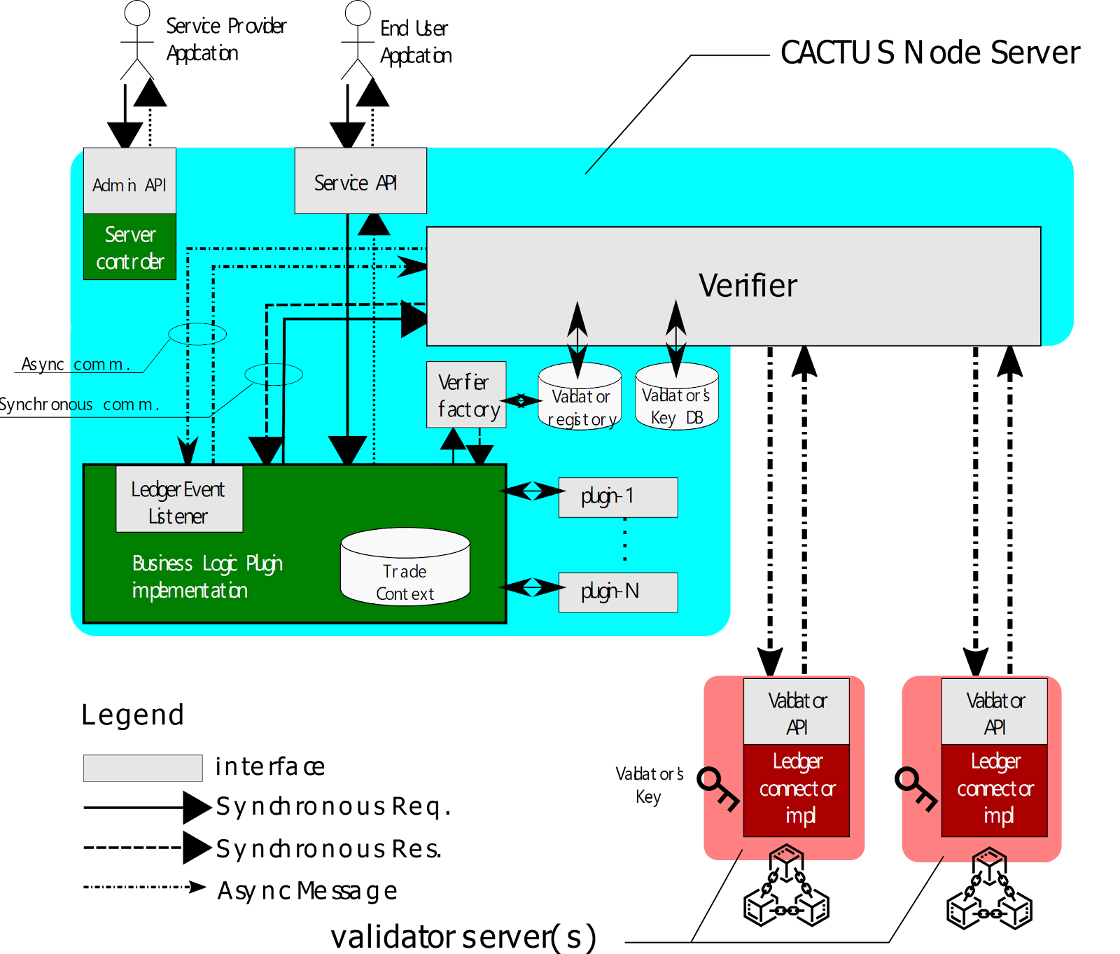
Architecture
Notes:
This image depicts the architecture of Hyperledger Cactus. Now, I will explain the key components:
Business Logic Plugin: The entity executes business logic and provide integration services that are connected with multiple blockchains. The entity is composed by web application or smart contract on a blockchain. The entity is a single plugin and required for executing Hyperledger Cactus applications.
CACTUS Node Server: The server accepts a request from an End-user Application, and return a response depending on the status of the targeted trade. Trade ID will be assigned when a new trade is accepted.
End-user Application: The entity submits API calls to request a trade, which invokes a set of transactions on Ledger by the Business Logic Plugin.
Ledger Event Listener: The standard interface to handle various kinds of events(LedgerEvent) regarding asynchronous Ledger operations. The LedgerEvent will be notified to appropriate business logic to handle it.
Ledger Plugin: The entity communicates Business Logic Plugin with each ledger. The entity is composed by a validator and a verifier as follows. The entity(s) is(are) chosen from multiple plugins on configuration.
Service Provider Application: The entity submits API calls to control the cmd-api-server when it is enabling/disabling Ledger plugins, or shutting down the server. Additional commands may be available on Admin API since Server controller is implementation-dependent.
Validator: The entity monitors transaction records of Ledger operation, and it determines the result(success, failed, timeouted) from the transaction records. Validator ensure the determined result with attaching digital signature with "Validator key" which can be verified by "Verifier".
Validator Server: The server accepts a connection from Verifier, and it provides Validator API, which can be used for issuing signed transactions and monitoring Ledger behind it. The LedgerConnector will be implemented for interacting with the Ledger nodes.
Verifier: The entity accepts only successfully verified operation results by verifying the digital signature of the validator. Verifier will be instantiated by calling the VerifierFactory #create method with associated with the Validator to connect. Each Verifier may be temporarily enabled or disabled. Note that "Validator" is apart from "Verifier" over a bi-directional channel.
Verifier Registry: The information about active Verifier. The VerifierFactory uses this information to instantiate Verifier for the Business Logic Plugin.

Slide 13
Use Cases
Healthcare
Food Traceability
Identity Management
Money Exchange
Data Transaction
Asset Transfer
Notes:
Healthcare: This is a popular use case for Hyperledger Cactus. The healthcare industry has been struggling with data sharing. The use of blockchain technology enables them to share data among themselves. However, the use of different blockchain technology means the need for proper data exchange and interoperability. This is where Hyperledger Cactus comes into picture. Cactus also provides access control and privacy features with which patients can share their data with healthcare providers as they wish.
Food Traceability: In the food supply chain, the organizations handling the food can better interact with each other by ensuring that separate services/products can still synchronize and verify the origin of the food products sold at retail outlets. This means that the food manufacturer can share the information with other players in the food chain without the need to create a separate solution for it as it can be solved by Cactus. The retailer needs to integrate Cactus as an architectural component and provide an interface to the consumer to trace food during the supply chain.
Identity Management: Offers wallet identity authentication across different ledgers through a single interface
Money Exchange: It enables cryptocurrencies to get pegged against stable coins
Data Transaction: It facilitates peer-to-peer data/document transaction
Asset Transfer: It allows to transfer funds from one ledger to another through Escrowed Asset Transfer social interaction.

Slide 14
Consensus Algorithm and Smart Contracts
Hyperledger Cactus and Hyperledger Explorer are Tools. They are not blockchains like Hyperledger Fabric, Ethereum etc.
So, Consensus Algorithm and Smart Contracts do not apply for Cactus and Explorer.
This is the reason we cannot explain about Consensus and Smart Contracts.
This slide is present because sir suggested us to mention this during the presentation.

Slide 15
Coming Up next…
Downloading, Installation and Deployment of the tools

Slide 16


